Slide 1

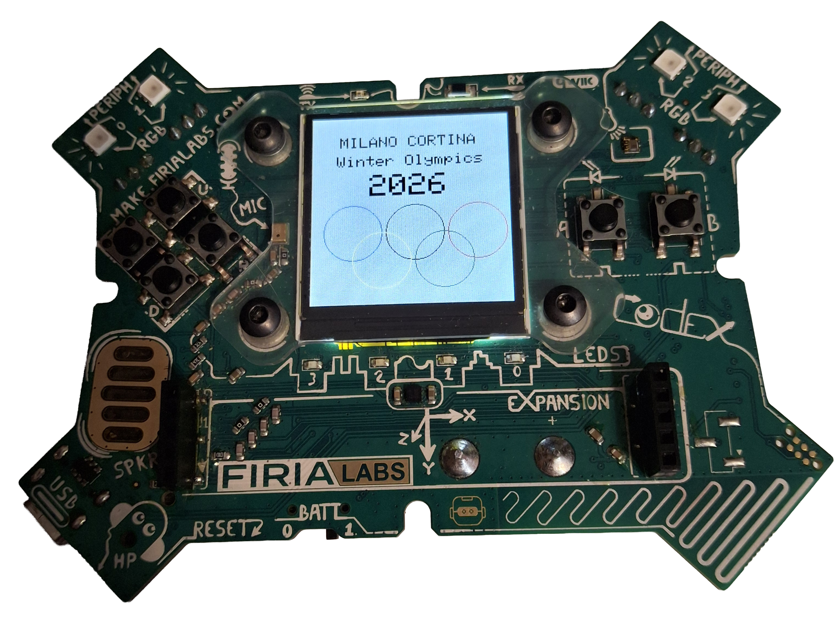
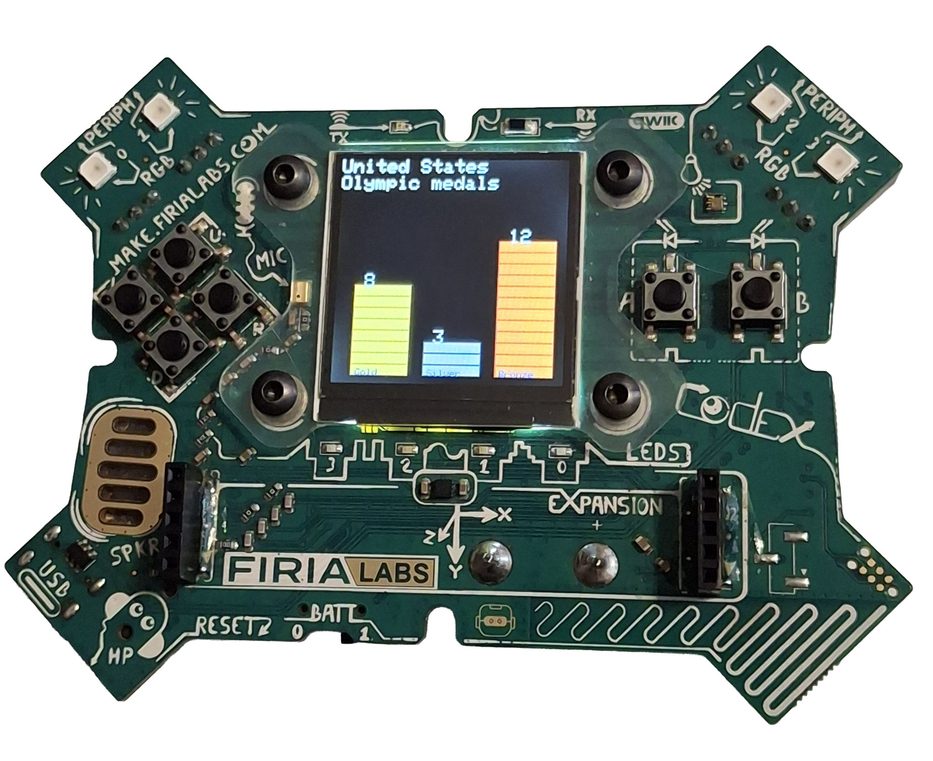
Winter Olympics
Monthly Project

Slide 2
2026 Winter Olympics Project
Use your CodeX to display the Olympics logo and medal count

Slide 3
February kicks off the Winter Olympics
Show your team spirit by displaying the Olympics logo and medal count for the country of your choice.
Grab your CodeX device…
Let’s write some code!

Slide 4

Getting Started
You will use CodeSpace for this project.
Go to make.firialabs.com
Log in (use your account)
Go to the Sandbox
  Icon on the right side bar, near the bottom

Slide 5

Getting Started
In the text editor:
Start a new file: olympics_2026
Import the codex library

Slide 6
2026 Winter Olympics Project
Part 1

Slide 7
Step 1
Define a function for the logo.
The logo has five circles, each a different color: Blue, Black, Red, Yellow and Green.
You will want to set the background to a different color so all the rings show up.
You will want to test as you go, so call the function.

Slide 8
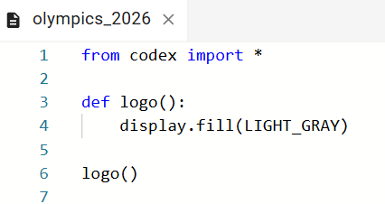
Step 1

Slide 9
Step 2
Add code for the first ring.
Text will go across the top, so start the ring about halfway down the display screen.
Make the radius of the circle around 30 to 35.
Run the code and get the circle just the way you want it.

Slide 10
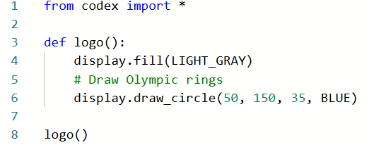
Step 2
x position, how far over
y position, how far down
radius

Slide 11
Step 3
Add circles for BLACK and RED.
Keep the same y position.
Keep the same radius.
Increment the x position by the radius * 2 plus a little more (like 5).

Slide 12
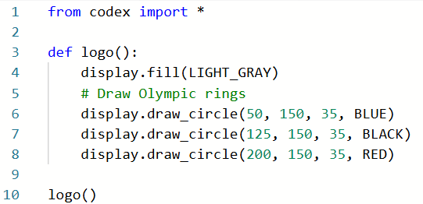
Step 3

Slide 13
Step 4
Add circles for the second row.
The x position should be halfway between the top circles.
Add the radius to the first row y position to get the second row y position.
Keep the same radius.

Slide 14
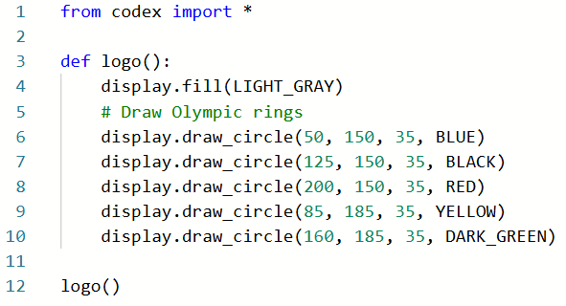
Step 4

Slide 15
Step 5
Add text to the logo.
The text will go on top of the circles.
Display the host country, Winter Olympics, and the year.
Use the display.draw_text() command.

Slide 16
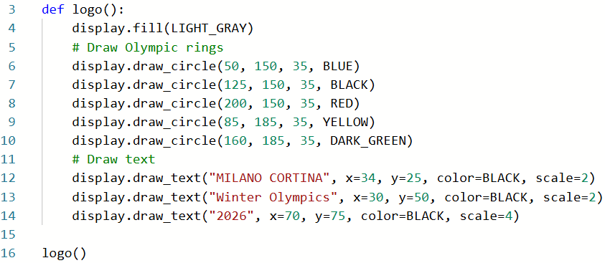
Step 5

Slide 17
Try it
Run the code
Press the
Make any adjustments to the circles and text.

Slide 18
2026 Winter Olympics Project
Part 2

Slide 19
Step 6
Display the medals for a country.
For this task, you will ask the user to type information for the CodeX.
You can do that using the console!
Not only does the console print information, but you can also type directly into the console, and the information is inputted to the CodeX.

Slide 20
Step 6
Define a new function for getting information.
First clear the display.
Use display.print() to give instructions on the CodeX to type in the console.
You aren’t testing the logo function anymore, so you don’t need to call it.

Slide 21
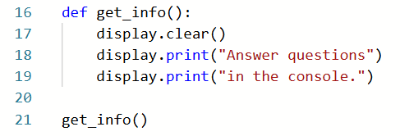
Step 6

Slide 22
Step 7
Use the input() command to get information from the console.
Anything typed in the Console is a string data type.
For the medal count, you will want integers.
Convert the string to an integer using int().

Slide 23
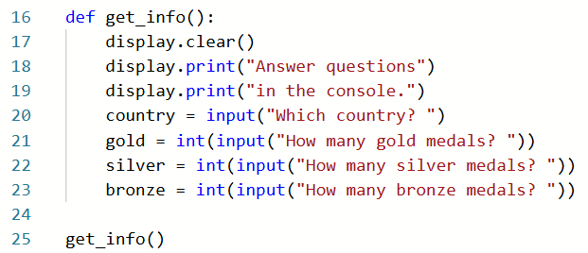
Step 7

Slide 24
Try it
Run the code.
Press the
You should see instructions on the CodeX, and you should also be able to type the answers on the console.

Slide 25

Step 8
This function is just part of the algorithm.
Return the variables in the function.
Call the function in another function called stacks().
Display the country on the screen.

Slide 26
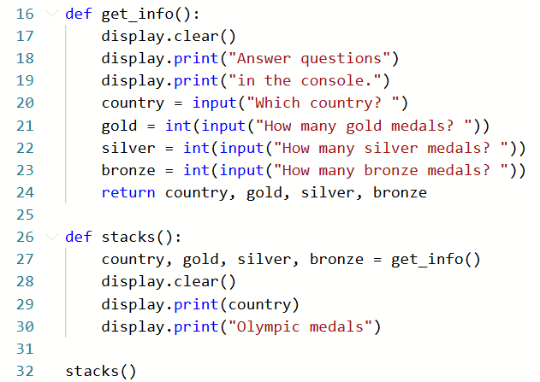
Step 8

Slide 27
Step 9
Define a function that will display a bar chart for a medal.
For parameters, you will need the number of medals, the starting position for x, and two colors.
The bars will always start at the bottom (y = 220).
You will do a filled-in rectangle in one color, and an outline of the rectangle in another color.

Slide 28
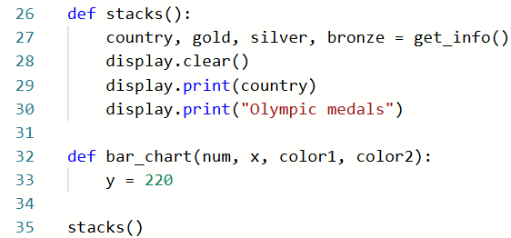
Step 9

Slide 29
Step 9
Use a for loop to create the bars.
You can decide the width and height of your bars.
Inside the loop, decrement y by the height.

Slide 30
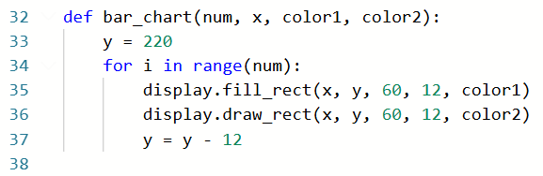
Step 9
width
height

Slide 31
Step 9
Call the bar_chart() function for the gold medals.
Think about where you want the edge of the bars to be (the x, or how far over).
Select a color for the medal (like YELLOW) and a color for the outline (like ORANGE)
Run the code and make any adjustments before calling the function for silver and bronze.

Slide 32
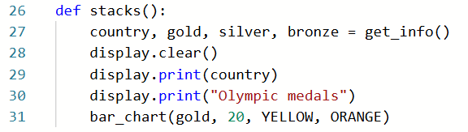
Step 9

Slide 33
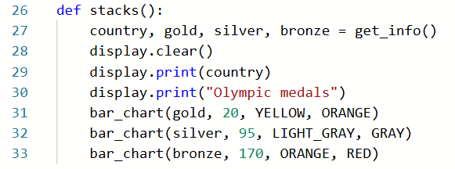
Step 9
Then call the function two more times for silver and bronze. Adjust the x value for each function call.

Slide 34
Step 10
Almost done! Let’s create a main program that can call either the logo or the stacks of medals.
Delete any current function calls.
Use a while True loop.
Use a button press for the logo.
Use a different button press for the medal stacks.
You can even use a button press to clear the screen and stop the code.

Slide 35
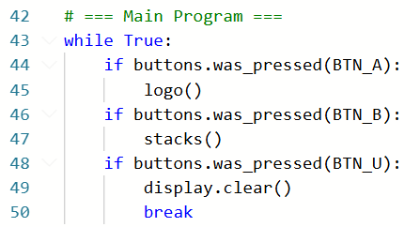
Step 10

Slide 36
Try it
Run the code.
Press the
Display the logo, and type information to display medals.
You are ready for the Winter Olympics!

Slide 37
Extensions
Add an introduction, so when the code starts, you know what to do.
Add labels for the bar chart.
Use variables for the logo’s circles so the logo can be placed randomly.
Use overlapping circles for the medals instead of rectangles.
Use random circles for the medals.
Have the medals start near the top of the screen and fill in downward.
Display data for more than one country.

